Slide 1

SAT & ACT Analysis
Prepared by: Esther Leung

Slide 2
Problem Statement
Following the change in SAT format in March 2016, the College Board is keen to identify ways to improve SAT participation rate.

Slide 3
Data
In this analysis, the following data for SAT and ACT in the year 2017 and 2018 are analysed:
Participation Rate of each test by state
Average Test Scores of each test by state

Slide 4
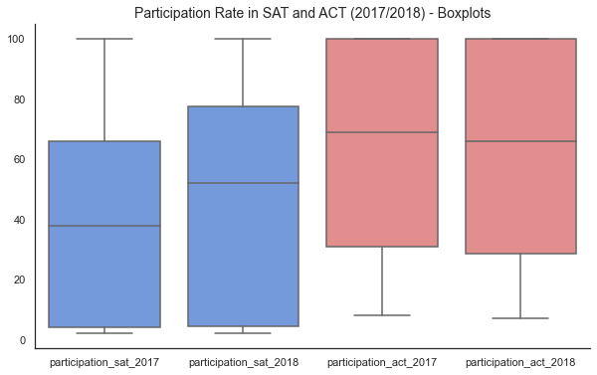
In both 2017 and 2018, ACT had higher median participation rate vs. SAT.

Slide 5
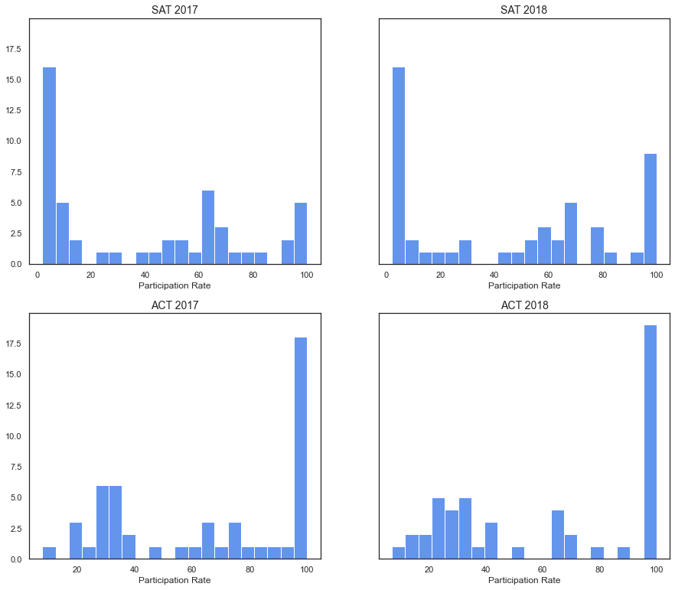
A third of the states had 100% ACT participation in 2017 and 2018. Mirroring this, a similar proportion of states have low SAT participation rate in both years. Notably, the number of states with strong SAT participation has increased in 2018.

Slide 6
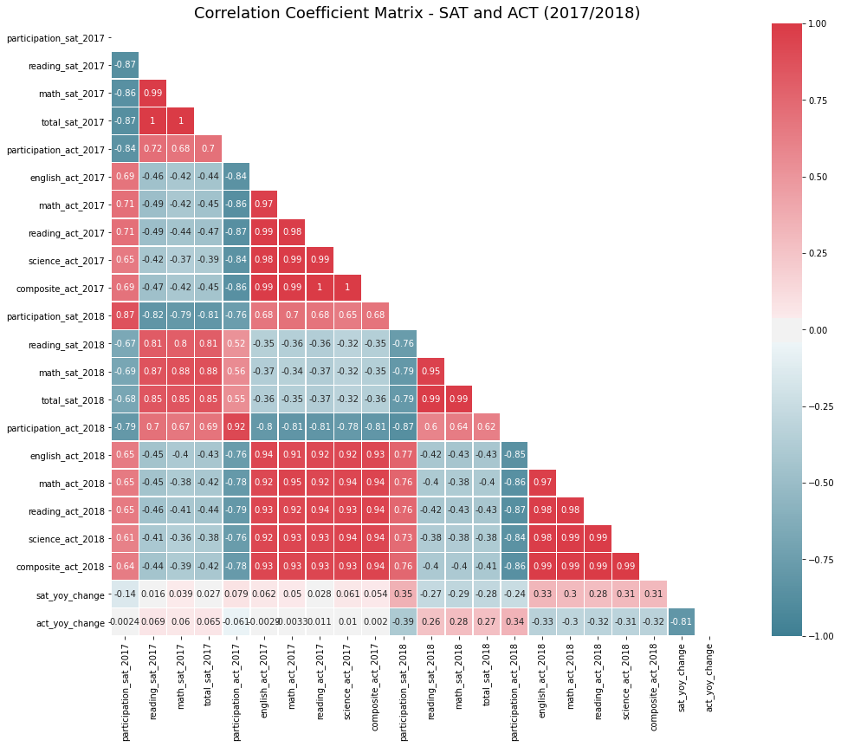
No evidence of prior year test score as a driver of SAT participation
High SAT scores in 2017 does not correlate to high SAT participation rate in 2018.
Similarly, low ACT scores in 2017 also does not correlate to high SAT 2018 participation.

Slide 7
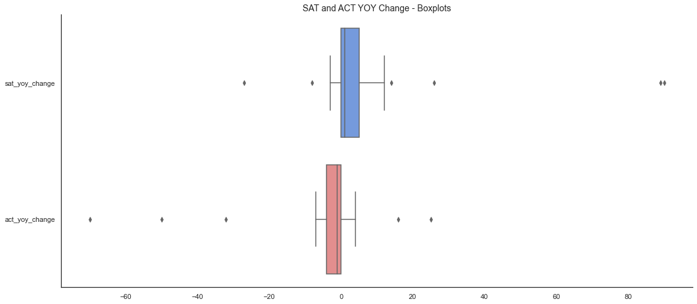
Sharp increase in SAT participation rate seen for Colorado and Illinois, along with decline in ACT participation, indicates conversion from ACT to SAT. Rhode Island also saw a notable increase in SAT participation.
Colorado
SAT yoy change: +89%
ACT yoy change: -70%
Illinois
SAT yoy change: +90%
ACT yoy change: -50%
Rhode Island
SAT yoy change: +26%
ACT yoy change: -6%

Slide 8
State contracts and state funded test are key driver of SAT participation rate in Colorado, Illinois and Rhode Island in 2018.
In 2017-2018, 10 states (Colorado, Connecticut, Delaware, Idaho, Illinois, Maine, Michigan, New Hampshire, Rhode Island, and West Virginia) and the District of Columbia covered the cost of the SAT for all their public school students.
Three years prior to that, only three states and the District of Columbia did so.
Source:
https://www.edweek.org/ew/articles/2018/10/31/sat-scores-rise-as-number-of-test-takers.html
https://www.chicagotribune.com/news/ct-illinois-chooses-sat-met-20160211-story.html
https://co.chalkbeat.org/2015/12/23/21092477/goodbye-act-hello-sat-a-significant-change-for-colorado-high-schoolers
https://www.edweek.org/ew/section/multimedia/states-require-students-take-sat-or-act.html

Slide 9
Conclusion & Recommendation
State contracts and state funded test are key drivers to SAT participation.
It is recommended that the College Board focuses on developing partnership with states that do not have any prevailing contract awarded to either the College Board or ACT, and currently have low SAT participation in 2018.
Examples of such states include Iowa, Kansas, and South Dakota.

